Slide 1


Model-based medical image analysis
Ela Claridge
School of Computer Science

Slide 2
Image formation

Slide 3

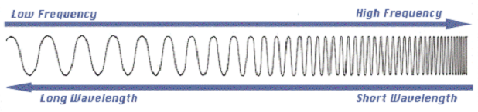
Spectral properties
Amplitude
800 nm = 3.8 x 10¹⁴ Hz
400 nm = 7.5 x 10¹⁴ Hz

Slide 4

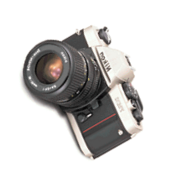
What’s in the image data?
Contributing factors
Light
Object
Imaging system

Slide 5
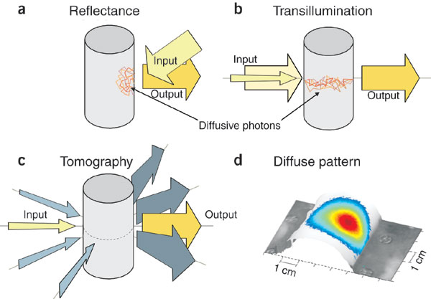

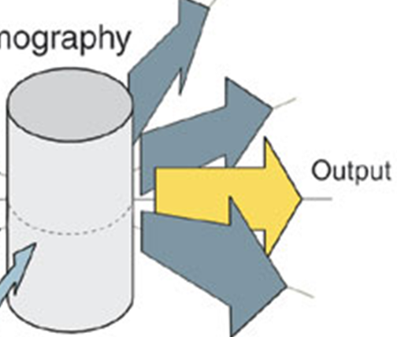
Diagnostic imaging
Emission
Looking and listening to light: the evolution of whole-body photonic imaging
Ntziachristos et al. Nature Biotechnology 23, 313 - 320 (2005)

Slide 6
Modelling of image formation
Input
Input
Output
Output
Transmission
Reflectance
Input
Source
Output
Output
Output
Tomography
Emission

